Slide 1
Resources vs. Mars
Code Memory
CPU
Instructions
Registers
Program Code
PC
ALU
Addresses
Data Memory
Condition
Codes
Data
Program Data

Slide 2
Directives
Directives for data structure
.ascii (store string in memory with no null-termination)
.asciiz (store string in memory with null termination)
.byte b1,..,bn
.word w1,..,wn
.word w:n (store w into n successive words)
.space n
.data data segment
.text assembly instructions

Slide 3
Data Transfer instructions
Data Transfer | la Rd, Label | Load
 | lb $t, offset($s) |  | $t = MEM[$s + offset];
 | li Rd, value
 | lui $t, imm |  | $t = (imm << 16);
 | lw $t, offset($s) |  | $t = MEM[$s + offset];
 | sb $t, offset($s) | Store | MEM[$s + offset] =(0xff & $t);
 | sw $t, offset($s) |  | MEM[$s + offset] = $t;
 | move Rd, Rs | Reg <-> Reg

Slide 4
Register data
Load
Constant (literal) – load immediate
li $t0,0x3f # R[$t0] = 0x3f
From another register -- move
move $t1,$t0 # R[$t1] = R[$t0]
or $t1, $t0, $0
From data memory – load word
lw $t1,??? # load a memory word
For ALU Operation: Read from register
add $t2, $t1, $t0 # R[$t2]=R[$t1]+R[$t0]

Slide 5
Operand Addressing
Source
Destination
C Analog
Imm
Reg
li $t1, 0x4
temp = 0x4;
Addr
Reg
la $t1, A
temp2 = &A;
Reg
Mem
sw $t1,A($t2)
A[n] = temp;
Mem
Reg
lw $t1,A($t2)
temp = A[n];
No instruction for reg-to-reg transfer
Cannot do memory-memory transfers with single instruction
sw instruction violates (dest, source) spec of operands

Slide 6
Memory data
Data memory – initialize a block
var: .word 0, 0x3f
.word 0:30 # 30-word block
Store into data memory -- only via a register
sw $t0, var
sw $t0, var+4 # var+4
sw $t0, 4($s0) # R[$s0]+4
sw $t0, var($s0) # R[$s0]+var
Retrieve from data memory – only to a register
lw $reg, Source

Slide 7
Addressing Modes
Addressing Modes
Direct
memory address is specified
lw $t1, var
Indirect (R) Mem[Reg[R]]
Register R specifies memory address
lw $t1, ($t2)
Indexed D(R) Mem[Reg[R]+D]
Register R specifies start of memory block
Constant displacement D specifies offset
lw $t1, 8($t2)
lw $t1, var($t9)

Slide 8
ALU instructions
Arithmetic | abs Rd, Rs | abs
 | add $d, $s, $t | add | $d = $s + $t
 | addi $t, $s, imm |  | $t = $s + imm
 | addiu $t, $s, imm |  | $t = $s + imm
 | addu $d, $s, $t |  | $d = $s + $t;
 | sub $d, $s, $t | sub | $d = $s - $t;
 | subu $d, $s, $t |  | $d = $s - $t;
 | mul Rd, Rs, Rt
 | div Rd, Rs, Rt
 | neg Rd, Rs | neg | Rd = -Rs
 | negu Rd, Rs
Logical | not Rd, Rs | not | Rd = ~Rs
 | and $d, $s, $t | and | $d = $s & $t
 | andi $t, $s, imm |  | $t = $s & imm
 | or $d, $s, $t | or | $d = $s | $t;
 | ori $t, $s, imm |  | $t = $s | imm;
 | xor $d, $s, $t | xor | $d = $s ^ $t
 | xori $t, $s, imm |  | $t = $s ^ imm

Slide 9
Bit instructions
Bit manipulation | rol Rd, Rs, Rt | rotate
 | ror Rd,Rs,Rt
 | sll $d, $t, h | Shift left | $d = $t << h
 | sllv $d, $t, $s |  | $d = $t << $s
 | sra $d, $t, h | Shift right arithmetic | $d = $t >> h
 | srl $d, $t, h | Shift right logical | $d = $t >> h
 | srlv $d, $t, $s |  | $d = $t >> $s
6-bit value
001010 10
010100 20
<< 1 *2 >>1 /2
 | seq Rd,Rs,Rt | set
 | sge Rd,Rs,Rt

Slide 10
Branch/IO instructions
Flow Xfer | b Label | goto
 | beq $s, $t, offset |  | if $s == $t advance_pc (offset << 2));
 | beqz Rs, Label |  | beq Rs, $0, Label
 | bge Rs, Rt, Label
Function call | jal target | Jump and link | $ra: return address
 | jr $s |  | PC = nPC; nPC = $s;
 | jalr $r, $t |  | target addr in $t, return addr is $r
I/O | syscall

Slide 11
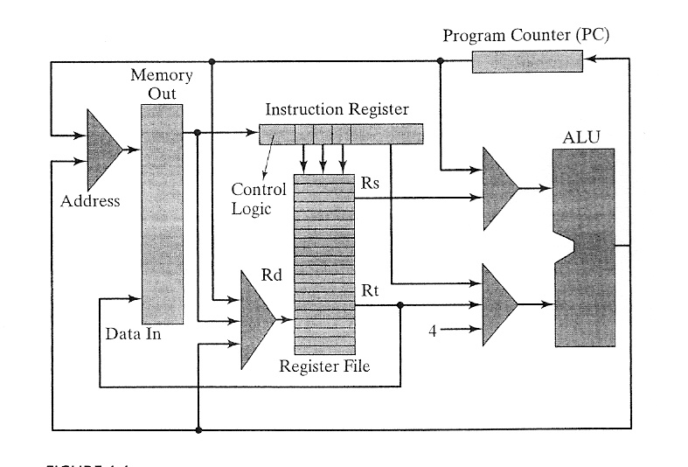
How to access a[1]?
X = a[1] (load word)
Compute Effective Address (address of a + index offset in bytes)
Transfer the effective address to Memory Address Register (MAR)
Read memory into Memory Data Register (MDR)
Transfer to CPU register
a[1] = X (store word)
Transfer register to MDR
Computer effective address to MAR
Write

Slide 12
How to add ?
X =X+Y
Transfer X, Y (in registers) to ALU (Arithmetic & Logic Unit)
Add
Transfer the sum to a register

Slide 13
I/O Instructions - syscall
http://courses.missouristate.edu/kenvollmar/mars/help/syscallhelp.html
Service | Call code ($v0) | Arguments (input) | Results
print integer | 1 | $a0 = integer | signed decimal integer printed in console window
print string | 4 | $a0 = address of string | string printed in console window
Read integer | 5 | (none) | $v0 holds integer that was entered
Read string | 8 | $a0=address to store $a1= length limit | characters are stored
exit | 10 | (none) | Ends the program

Slide 14
Square an input Number
printf(“Enter an integer to square: \n”);
scanf(“%d”, x);
printf(“%4d”, (x*x));
.data
prompt: .asciiz “Enter an integer to square:\n“ # message area
.text
main: # printf(“Enter an integer to square: \n”);
la $a0, prompt # get the address of the message to $a0
li $v0, 4 # read to display the message
syscall
# scanf(“%d”, x);
li $v0, 5 # read an integer into $v0
syscall
mul $a0, $v0, $v0 # squared input value, save in $a0
# printf(“%4d”, (x*x));
li $v0, 1 # print the squared value
syscall

